Slide 1
Core Java – Part 4

Slide 2
What we will cover today?
Inheritance
Packages
Final Modifier
Abstract class and Method
Interfaces
Inner classes
Coupling & Cohesion

Slide 3
Inheritance
Mechanism in which one object acquires all the properties and behaviors of parent object.
Create new classes that are built upon existing classes.
When you inherit from an existing class, you can reuse methods and fields of parent class, and you can add new methods and fields also.
Represents the IS-A relationship, also known as parent-child relationship.
Method Overriding (so runtime polymorphism can be achieved).
Code Reusability.

Slide 4





Object Oriented Features - Inheritance
Employee
Developer
HR
Java Dev
QA
.NET Dev

Slide 5
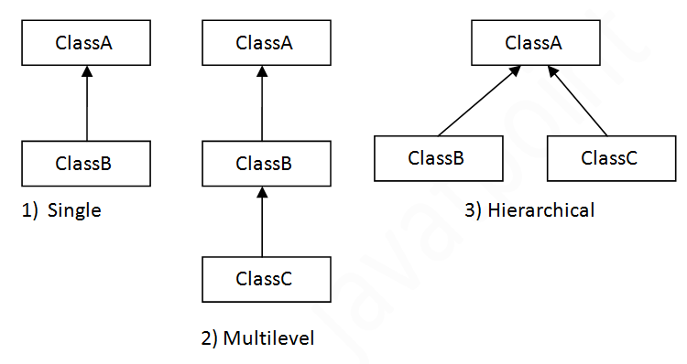
Types of inheritance in java
Multiple inheritance is not supported in java through class.

Slide 6
Syntax of Java Inheritance
class Subclass-name extends Superclass-name
{
//methods and fields
}

Slide 7
Few things about inheritance…
Allows creation of hierarchical classification
Reusability of code
Add/remove/update classes easily
Subclass extends superclass
Subclass inherits all the public & protected members of superclass but not the private members
Use IS-A test for verification
IS-A test is unidirectional

Slide 8
When to go for it… & when not!
Use inheritance when
One class is more specific type of a superclass
You have behavior that must be shared among many classes
Do not Use inheritance when
Subclass and superclass don’t pass IS-A test
Just to reuse the code from another class

Slide 9
super keyword in Java
Used to refer immediate parent class object. Usage of java super Keyword
Refer immediate parent class instance variable.
Invoke immediate parent class method.
Invoke immediate parent class constructor.

Slide 10
Method Overloading
It’s just reuse of method name
Methods from superclass can be overloaded in subclass
Reference Type determines which overloaded method will be used at compile time.
Overloaded Methods:
Must have different parameter list
May have different return types, if parameters are also different
May have different access modifier
May throw different exception

Slide 11
Method overriding
Overriding Method
must have exact parameter list. If it does not match, guess what will happen?
Use super.<method name> to call superclass version of method
Static methods can not be overridden
Actual object type determines which version of the allowed method will get executed.

Slide 12
Object Oriented Features - Polymorphism
Poly – ‘Many’ and morphs – ‘forms’
Type of reference variable can never change
But reference variable can point to any object of same type
OR any other object of its subtype.
Type of reference variable determines which methods can be called.
But which version of method is to be called, depends on the actual type of object

Slide 13
Assignment – Inheritance and Overriding
Consider a scenario, Bank is a class that provides functionality to get rate of interest. But, rate of interest varies according to banks. For example, SBI, ICICI and AXIS banks could provide 8%, 7% and 9% rate of interest.
Create a bank class and its child classes SBI,ICICI and AXIS and override getInterestRate method from parent class.

Slide 14
Assignment – Inheritance
Question
FillInQuestion
ChoiceQuestion
NumericQuestion
MultiChoiceQuestion
Question
- text (question):String - answer (correct ans):String
+ setText(String) + setAnswer(String) + checkAnswer(String):boolean + display() -> the question
ChoiceQuestion → Question
- choices[] :String
+ addChoice(String, boolean) + display()

Slide 15
Assignment – Inheritance
Question class
setText() sets the question
setAnswer() sets the correct answer for the question entered.
Display() – responsible for displaying the question to the user
checkAnswer(String ans ) -> checks the answer entered by the user against the correct answer.This method retruns true if answer entered matches the correct answer else false.
ChoiceQuestion → inherits Question class
This class represents the MCQ.
Call parent class setText() to set the question for mCQ
choices[] – takes the array of choices max 4 for a particular question
addChoice(String choice, Boolean correctans) -> this method adds choices in the array and calls setAnswer() of parent class to set the correct answer of the 4 choices.
Display() → override from the parent class and it displays the question and all the 4 choices to choose from to the user.
It calls checkAnswer() of parent class to verify the answer entered by the user.
Create a Question[] that stores ChoiceQuestion objects. Display question one by one from this array for the students to solve the assessment.

Slide 16
public class Question {
private String text;
private String answer;
public void setText(String text) {
this.text = text;}
public void setAnswer(String answer) {
this.answer = answer;}
public boolean checkAnswer(String response)
{return response.equals(answer);}
public void display(){System.out.println(text);}
}
public class TestQuiz {
public static void main(String[] args) {
Question q = new Question();
q.setText("Who was the inventor of Java?");
q.setAnswer("James Gosling");
presentQuestion(q);
ChoiceQuestion q1 = new ChoiceQuestion();
q1.setText("What was the original name of Java language");
q1.addChoice("*7", false);
q1.addChoice("Duke", false);
q1.addChoice("Oak", true);
q1.addChoice("Gosling", false);
ChoiceQuestion q2 = new ChoiceQuestion();
q2.setText("Country of inventor of Java language");
q2.addChoice("Australia", false);
q2.addChoice("Denmark", false);
q2.addChoice("Canada", true);
q2.addChoice("United States", false);
presentQuestion(q1);
presentQuestion(q2);
}
public static void presentQuestion(Question question)
{
question.display();
System.out.println("Your answer");
Scanner in = new Scanner(System.in);
String resp = in.nextLine();
System.out.println(question.checkAnswer(resp));
}}
public class ChoiceQuestion extends Question{
private String choices[];
private int i ;
public ChoiceQuestion()
{choices = new String[4];}
public void addChoice(String choice, boolean correct){
choices[i] = choice;
i++;
if(correct){setAnswer(choice);}
}
@Override
public void display() {
super.display();
for(int i=0;i<choices.length;i++)
{
int chnum = i+1;
System.out.println(chnum+" : "+choices[i]);
}
}
}

Slide 17
Packages
Containers for the classes that are used to keep class name compartmentalized.
Mechanism for partitioning the class namespace into more manageable chunks
No name clashes.
Stored in hierarchical manner. Defining Packages package pkg; Ex. package MyPackage;
.class files must be stored in a directory named MyPackage.
Creation of hierarchy of packages is also possible – package pkg1[.pkg2][.pkg3] – Ex. package java.awt.image;
Above file must be stored in java/awt/image , java\awt\image or java:awt:image folder on UNIX, Windows, or Macintosh file systems respectively.

Slide 18
Package - Structure
A p1 pub:String = "public" pri:String = "private" def:String = "default" pro:String = "protected”
A(){ //display values of all 4 members}
D extends A p2
D(){ //display values of all 4 members}
B extends A p1
B(){ //display values of all 4 members}
E p2
E(){ //display values of all 4 members}
C p1
C(){ //display values of all 4 members}

Slide 19
Rules of access specifiers
 | private | Default(package) | protected | public
Same class(A) | yes | yes | yes | yes
Class in same package(C) | no | Yes(w) | yes(w) | Yes(w)
Child class in same package(B) | no | Yes(w/o) | Yes(w/o) | Yes(w/o)
Class in other package (E) | no | no | no | yes
Child class in other package(D) | no | no | Yes(w/o) | Yes(w/o)
W – with object
w/o – without object

Slide 20
Import Packages
import pkg1[.pkg2].(classname|*); – import java.util.Date; – import java.io.*; Example: With Import Statement Without Import Statement
import java.util.*; class MyDate extends java.util.Date class MyDate extends Date { }

Slide 21
Final modifier
final variable
Impossible to reinitialize the variable again
But what happens in case of reference variable?
final method
You can never override this method in subclass
So nobody can change your implementation
final class
Final classes can never be sub classed.
Ex. String class in Java is a final class

Slide 22
Abstract methods
Declared but not implemented.
No method body and ends in semicolon.
ex. public abstract void makeNoise();
Force your subclass to provide implementation.
RULE: If you mark a method abstract, the class MUST also be marked as abstract
Implementing abstract method is same as overriding it.

Slide 23
abstract classes
You can never instantiate them
Its sole purpose is to be extended
You can use them as Reference type

Slide 24
Rules………..
Rule 1: If you are extending any abstract class that have abstract method, you must either provide the implementation of the method or make this class abstract.
Rule 2: If there is any abstract method in a class, that class must be abstract.
Rule 3: You cannot instantiate an abstract class.

Slide 25
Abstract Flow Chart
Item(abstract)
Furniture(abstract)
Chair(concrete)
Sofa(concrete)
Electronic(abstract)
TV(concrete)
DVD(concrete)

Slide 26
Remember inheritance tree for employee??
Employee
Developer
HR
Java Dev
QA
.NET Dev

Slide 27
Deadly Diamond of death
Class A
Test()
Class B
Test()
Class C
Test()
Class D
Test()

Slide 28
Interface in Java
Solves multiple inheritance problem without falling into DDD
Interface is like 100% pure abstract class.
So no implementation means no DDD problem.
The class which Implements the interface, must provide implementation for all interface methods.
Syntax for using interface:
public class <className> implements <interfaceName>
{
//provide implementation for interface methods…
}

Slide 29
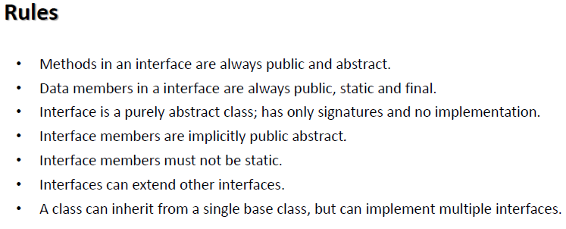

Slide 30
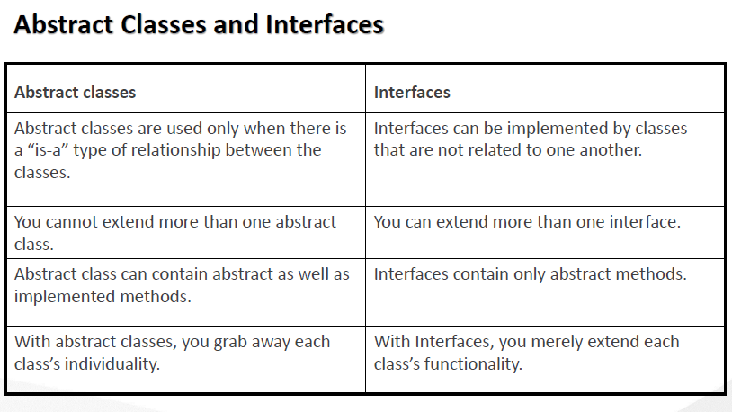

Slide 31
Inner Classes in Java
Class declared inside the class or interface.
Use to logically group classes and interfaces in one place so that it can be more readable and maintainable.
Additionally, it can access all the members of outer class including private data members and methods. Type Description Member Inner Class A class created within class and outside method. Anonymous Inner Class A class created for implementing interface or extending class. Its name is decided by the java compiler. Local Inner Class A class created within method. Static Nested Class A static class created within class.
Notes:
https://docs.oracle.com/javase/tutorial/java/javaOO/whentouse.html

Slide 32

Coupling
Pinky
Pappu

Slide 33
Coupling
While developing application, focus on…
- Ease of creation
- Ease of maintenance
- Ease of enhancement
The degree to which one class know about another class

Slide 34
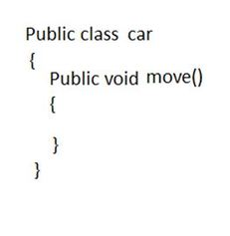
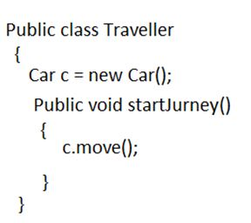
Identify the problem in this scenario…

Slide 35
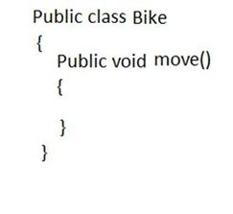
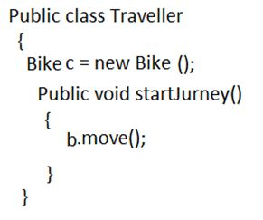
Need to make change in existing code… ☹

Slide 36
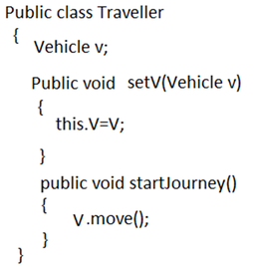
So the solution is…
Vehicle
Car
Bike
Traveller t = give me traveler
Vehicle v = give me vehicle
t.setV(v);
t.startJourney();

Slide 37
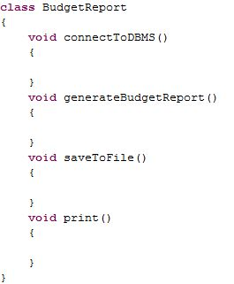
Cohesion
The degree to which a class has single & well focused purpose.

Slide 38
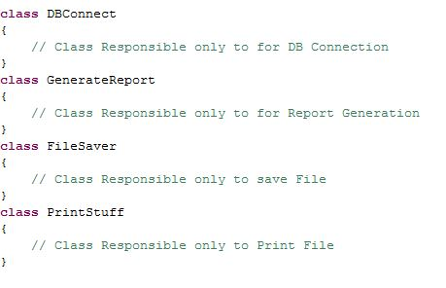
Solution…

Slide 39

Any Question ?

Slide 41

Thank you !

